Slide 1


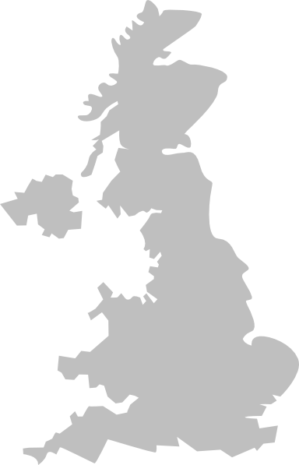
Introduction to Evolve: Our business
We are an independent corporate finance advisory firm committed to delivering excellent results through high quality, strategic advice
3 locations
100+ years
12 employees
5 key capabilities
Partner level experience
5 partners
7 deal team members
Sell | Buy | Debt
Equity | Retained advisory
Deal statistics
10+
£5m - £75m
Avg. 40%
Deals completed each year
Deals size sweet spot
Premium on sale mandates compared to base valuation
Nottingham
73%
67%
Birmingham (HQ)
80%
20%
Businesses sold to overseas buyers
Deals involving PE
Sell side
Buy side
London
Physical office
Satellite office

